Slide 1
PERANCANGAN APLIKASI PROJECT MANAGEMENT BERBASIS MOBILE DAN WEB
01
JOSIAH HANS SUJUDI - 01081180014

Slide 2
02
Agenda
Introduction
Purpose of the Study
Research Methodology
Limitation
Literature Review
Current System
Proposed Framework

Slide 3

Introduction
Lack of time and high demands on productivity, force people to think about speeding up processes. But in reality, it's not all about speed, it's also about quality. Speed and quality are often inversely related, and it's quite difficult to keep a balance between the two.

Slide 4
Purpose of the Study
Fill the gap regarding
Project Management
Simple system and tools that can manage ongoing or completed projects
Meetings
04
Difficulty in determining the meeting schedule

Slide 5
Limitations
Using flutter for implementing proposed system.
The proposed web application is for system administration purposes only.
Using PHP as a server-side programming language.
Does not provide cloud storage for storing files.
PMBOK-based Project Management.
Visualization of the project timeline using lists, boards and calendars.
Application users are students to professionals
05

Slide 6
Methodology
Data Collection Methodology
Literature Review
Questionnaire
Systems Development Methodology
Prototyping
06

Slide 7
07
01
Project Management
Project management is the application of processes, methods, skills, knowledge and experience to achieve specific project objectives according to the project acceptance criteria within agreed parameters.
02
PMBOK
Theoretical Basis
The Project Management Body of Knowledge is a set of standard terminology and guidelines (a body of knowledge) for project management.
03
Kanban
Kanban is a workflow management method for defining, managing and improving services that deliver knowledge work. It aims to help you visualize your work, maximize efficiency, and improve continuously. From Japanese, kanban is translated as billboard or signboard.

Slide 8
08
04
UML
The Unified Modeling Language (UML) is a general-purpose, developmental, modeling language in the field of software engineering that is intended to provide a standard way to visualize the design of a system.
05
Prototyping
Prototyping is an experimental process where design teams implement ideas into tangible forms from paper to digital. Teams build prototypes of varying degrees of fidelity to capture design concepts and test on users.
Theoretical Basis
06
Database
A database is an organized collection of data, generally stored and accessed electronically from a computer system. Where databases are more complex they are often developed using formal design and modeling techniques.

Slide 9
Theoretical
Basis
07
MariaDB
MariaDB Server is a popular open-source relational databases made by the original developers of MySQL. It is part of most cloud offerings and the default in most Linux distributions.
08
Flutter
Flutter is Google's SDK for crafting beautiful, fast user experiences for mobile, web, and desktop from a single codebase
09
HTML
HTML stands for Hyper Text Markup Language. HTML is the standard markup language for creating Web pages. HTML describes the structure of a Web page. HTML consists of a series of elements. HTML elements tell the browser how to display the content.
09

Slide 10
10
CSS
Theoretical
Basis
Cascading Style Sheets is a style sheet language used for describing the presentation of a document written in a markup language such as HTML.
11
Javascript
JavaScript is a scripting or programming language that allows you to implement complex features on web pages
12
PHP
PHP (recursive acronym for PHP: Hypertext Preprocessor) is a popular open-source scripting language that is especially suited for web development and can be embedded into HTML.
11
CodeIgniter 4
10
CodeIgniter is a powerful PHP framework with a very small footprint, built for developers who need a simple and elegant toolkit to create full-featured web applications.

Slide 11
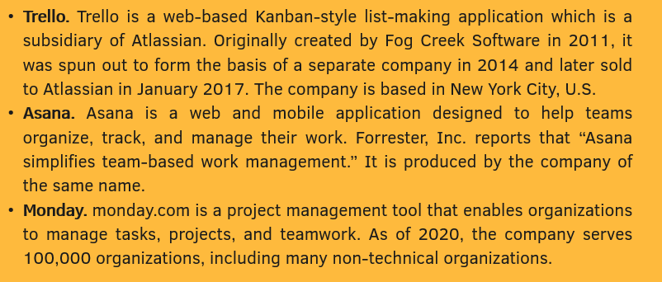
Current System
Related Application
10

Slide 12
Current System Problems
11
Features and Tools
Application features are only in the form of time management
Visualization
Usually only use a kanban board so it is very difficult for the novice to understand

Slide 13
12
All-in-One Mobile Apps
Rich of features and technology
Automated Scheduling
Proposed Framework
One-click to create a meeting
Various Visualization
Using List, Calendar, and Kanban Board

Slide 14

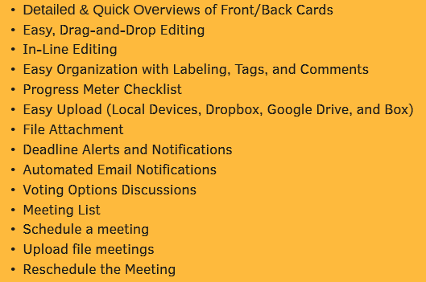
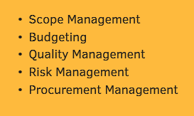
All-in-One Mobile Apps
Various features and tools
13

Slide 15



Automated Scheduling
We are integrating your calendar from your various calendars, such as Google calendar, Outlook calendar, or even phone calendar.
By using base64 algorithm, conflict-detection algorithm, and automation algorithm, we are going to make an automated scheduling tools that allow you to schedule a meeting effortlessly

Slide 16
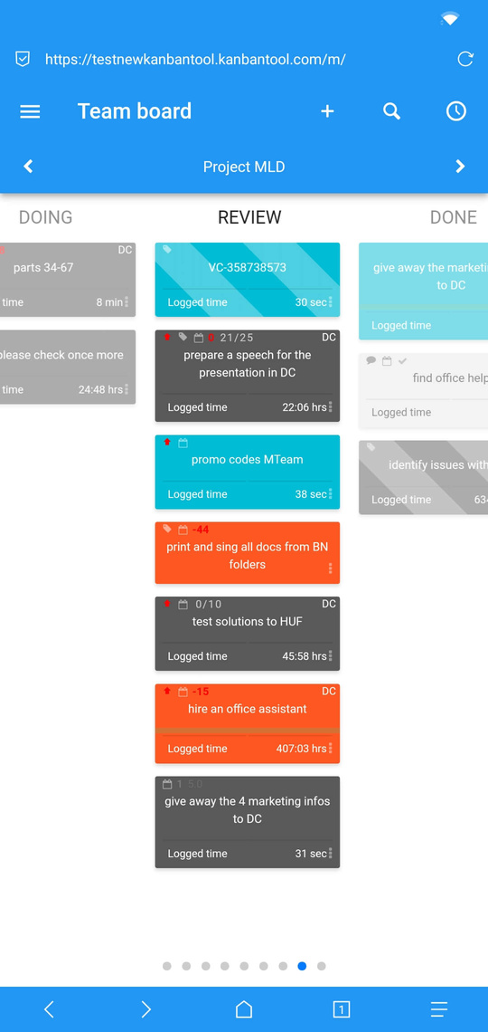
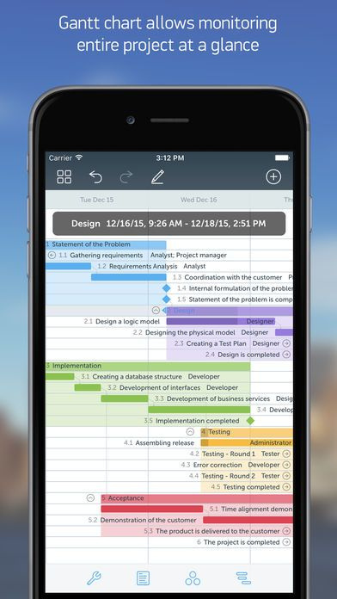
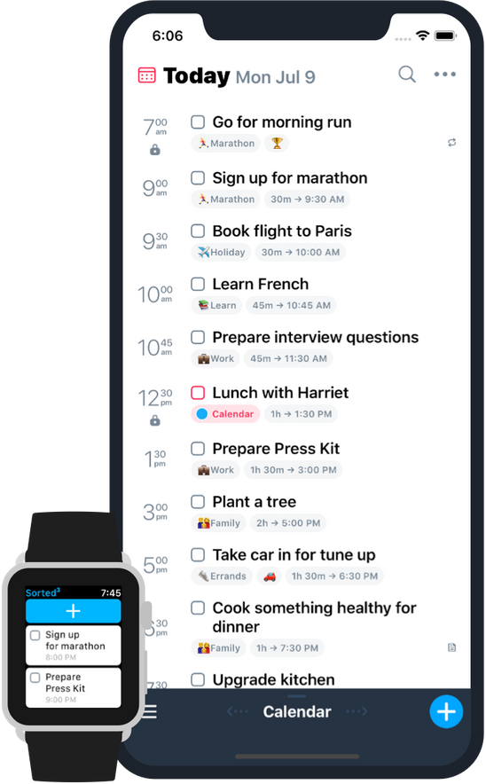
15
Various Visualization

Slide 17
Thank You!
Email me at josiah.jhs@gmail.com
for comments or questions.

